Slide 1
Demonstrating Realistic Avatar Control in a Virtual Environment Through the Use of a Neural Impulse Actuator
MS Project
Author: Emmett Coakley
Advisor: Joe Geigel
Observer: Hans-Peter Bischof
Reader: Reynold Bailey

Slide 2
Outline
Intro – Overview of avatar interaction
Types of EEGs [Emotiv, NIA, etc]
Hypothesis
Explain NIA/VT environment
Explain how the system will work.
Overview of Software/Hardware and modifications:
NIA/VT
Events
Event Triggers, Neural Triggers, Requiarements, Actions, etc.
Show all events
Demo
Explain
Actually demo
Results
Each test + analysis
Conclusion
Questions/Comments

Slide 3
Abstract / Overview
Project’s Purpose:
To develop techniques for improving realism within the field of three-dimensional avatar control.
How this was Accomplished:
Use of a Neural Impulse Actuator headset as a substitute for a hand-based peripheral device.
A series of headset-based trigger events were implemented, each of these allowing the user to alter the environment based upon a series of neural preconditions.
The project’s success rate was based upon how well a new user was able to interact within the environment with regards to:
Adapting to the system.
Influencing the virtual world.
Performance time of neural-based commands vs keyboard commands.

Slide 4
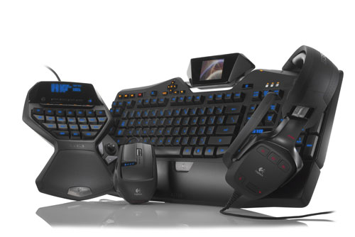
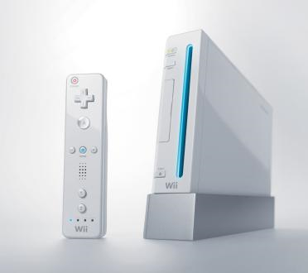
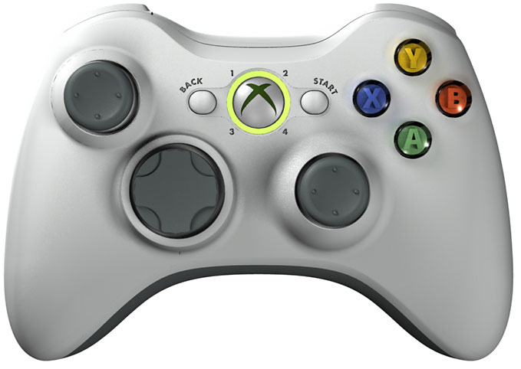
Introduction – Avatar Control
Recent technological innovations on both the software and hardware levels allow for users to assume a high level of realism and authenticity in the realm of avatar control within a virtual environment.
The majority of avatar-interfaces center on some form of peripheral device, such as a keyboard or game controller.
Logitech Keyboard
Xbox 360 Controller
Nintendo Wii

Slide 5
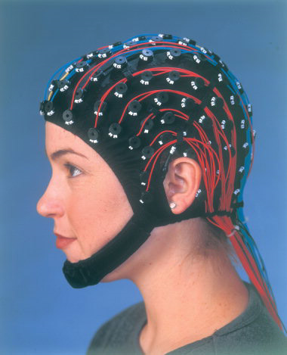
New Peripheral: Electroencephalograph (EEG)
A new type of peripheral device for avatar control: commercial electroencephalographs (EEG).
An EEG device is placed upon a user’s scalp, and is able to read the electrochemical impulses that flow across a person’s forehead.
These signals are then translated by the device’s software into a series of human-readable brainwave values.
Cost of Medical EEG: $50,000 – $200,000
Above Picture: http://upload.wikimedia.org/wikipedia/en/b/bf/EEG_cap.jpg

Slide 6
Dueling Headsets
Emotiv vs NIA goes here

Slide 7
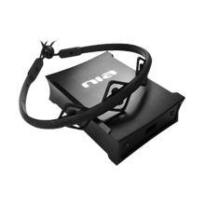
NIA – Neural Impulse Actuator
The Neural Impulse Actuator’s commercial purpose is to allow its software to mask over an executable program (videogames, specifically) and allow for neural impulses to be read, translated, and then sent to the executable as a command.
The NIA is comprised of several components: headset, box, and client.
Headset: Interprets the bioelectrical feedback across a user’s scalp via three saline sensors.
Box: Grounding and interpreting peripheral hardware which connected the headset to the PC’s USB drive. Dissipates white noise when grounded to the user’s body.
NIA Client: Software which relays the binary impulse signals sent from the box and passes them onto an executable program based upon a mask file’s specifications.
Designed for use using the NIA 4.0.1 beta client on Windows 7 (32bit)

Slide 8
NIA - Modifications
Designed a mask which would allow for the NIA Client to use the Virtual Theatre Software as an executable program.
The mask (NIAClient.nia) will send a variety of neural impulse commands to the Virtual Theatre Software.
Impulses Sent: Alpha, Beta, and Tension.

Slide 9
Virtual Theatre
Produced by a core team coming from multiple disciplines.
Uses motion capture systems and proprietary control systems to present live theatrical performances on virtual stages.
Funded by the National Science Foundation, Grant Number: 0713201

Slide 10
Virtual Theatre
A 3-dimensional Virtual Environment that allows for avatar and object generation.
Designed for use by the Luster runtime engine.
Avatars can be controlled (via keyboard control) in the 3D Virtual Environment.
The 3D World is designed via meshes, avatars, skeletons, particles, C++ plugins, particles, audio, and lua files.
Environment is modified via Client and Server calls. Multiple clients can modify a single server.
Designed for use with the Luster runtime version 0.19.5f on Windows 7 (32bit).

Slide 11
Virtual Theatre - Modifications
Event triggers, which added, modified, or removed existing objects within the virtual space based upon when certain neural impulse requirements are met.
NIAClient.lua: A demonstration program which allowed for a standalone version of the virtual environment to exist, ie. the server is also the client. Incorporated the newly designed events, as well as received input data from both keyboard and NIA impulse commands.
Avatars.lua: Objects were classified as avatars, and were made controllable by user via the NIAClient.lua and event code.
Cues.xml: Individual cues which allowed for the creation/destruction of avatars, lighting, and particle effects. Additional cues were added for new events.

Slide 12
Events - Overview
Events allow for a user’s avatar to be able to interact with the environment.
Events were comprised of three distinct portions: Triggers, Requirements and Actions.
Triggers were the input commands which signaled that an event should be activated.
Requirements were the preconditions which needed to be satisfied before that event could be performed.
Actions were the consequential events which occurred once the preconditions were met.

Slide 13
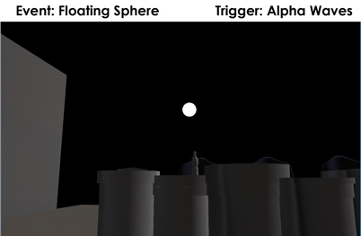
Event Name: Floating Sphere
Trigger:
[Impulse] - Alpha Spike must be between 70% and 100%.
Requirements:
A ball cannot already exist within the current space.
Alpha Waves must be dominant.
Action:
Generate a controllable 3D sphere which can be pushed or pulled through space.

Slide 14
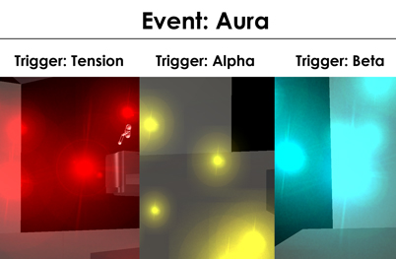
Event Name: Aura
Trigger:
[Impulse] - The wave must be between 70% and 100% impulse level.
Requirements:
One wave (Alpha, Beta, or Tension) is dominant.
Action:
Depending upon which impulse wave is dominant, the avatar will emit a wave of orbs. The color of these orbs is dependent upon the current dominant wave. Red for Tension, Yellow for Alpha, and Blue for Beta.

Slide 15
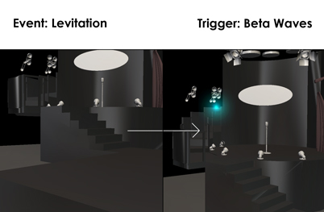
Event Name: Levitation
Trigger:
[Impulse] - Beta Spike must be between 35% and 100%.
Requirements:
Beta Waves must be dominant.
Action:
The avatar will steadily rise for a few seconds before stopping, hovering slightly over the ground. After 10 seconds, the avatar will slowly return to its original position.

Slide 16
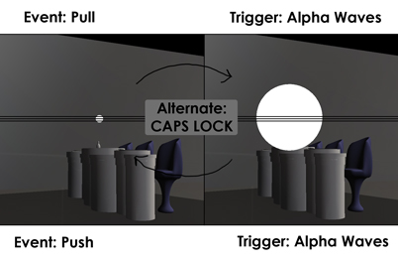
Event Name: Push/Pull
Trigger:
[Impulse] - Alpha Spike must be between 50% and 100%.
Requirements:
After movement, the object will not be placed within a restricted area.
Alpha Waves must be dominant.
Action:
An object moves further/closer in relation to the avatar at a specified speed for a limited time.

Slide 17
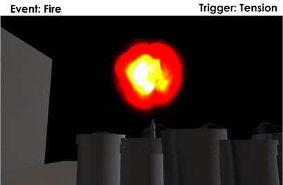
Event Name: Fire
Trigger:
[Impulse] - Tension must be between 50% and 100%.
Requirements:
A ball must exist within the 3D space.
Action:
The floating sphere bursts into flames for 10 seconds.

Slide 18
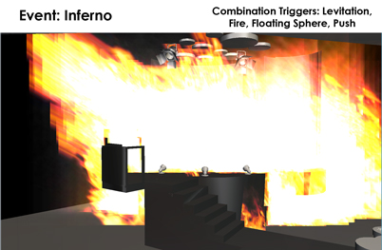
Event Name: Inferno
Trigger:
The floating sphere must exist within a specified portion of the 3D space.
Requirements:
The floating sphere must be on fire.
Action:
A massive firestorm erupts at a given location.

Slide 19
Merging Projects – NIA Side
Coding Task 1:
Allow for the NIA headset to be able to communicate with the Luster environment.
This was done by developing a .nia mask file.
Nia Mask File:
The file “VT-Nia.nia” informs the NIA client to send a variety of key commands in response to a spike of brainwave activity.
For instance, the Levitation Event had an Impulse Trigger of 35% Beta Spike. This would translate to whenever the NIA client interpreted that Beta waves were acting between 35-100%, the button command “55” (Spacebar) would be issued to the Virtual Theatre executable.
The Virtual Theatre program would then factor the key command into whether or not an event could be triggered at that exact moment.

Slide 20
Merging Projects – NIA Side
Coding Task 2:
Allow these input commands to be interpreted as impulse triggers. In order for an event to become active, the event needed to have its impulse and environment requirements met.
Accomplished:
The system itself was threaded with event listeners, each of which monitored for any of the possible impulse commands.
If any were given, a notification was sent to each of the possible events which could utilize the trigger.
Whenever “button 55” was issued, an immediate command was sent to the Levitation event informing it that one of the requirements was met.
In this manner, the Virtual Theatre software was able to keep track of the impulse commands being read via the NIA headset as well as those specifically being sent out as ordered from the VT-Nia.nia file as well.

Slide 21
Merging Projects - Neural
Specifically, the mask was also be to allow for both the informing of the Virtual Environment whenever a spike would trigger, as well as whether or not the spike was still triggering. Event Listeners were designed to be mapped to each possible trigger, and to keep track of both when they were activated as well as when they were deactivated. Neural activity works in such that when a certain method of thinking is applied, a greater ratio of wave activity increases. This does not mean that when a user is in a state of active thinking will constantly generate high levels of alpha waves. Instead, the user generates a high frequency of alpha wave spikes. The same works with beta waves as well; a person meditating will not have high levels of beta wave activity, as much as a high frequency of high beta wave spikes. The Event Listeners enable the VT client to be able to interpret exactly when a spike begins as well as when it ends. This allowed for the Virtual Theatre environment to be able to track which waves are currently spiking, as well as a greater level of control over the impulse triggers on the side of the events themselves.

Slide 22
Demo – Full Mental Arsonist

Slide 23
Merging of Projects
Project Idea:
Combining a Neural Impulse Actuator (NIA) headset with and a basic motion capture suit in order to allow for the generation of events in a real-time virtual environment.
Main Purpose:
Allow for a new form of hands-free interaction within virtual space.
Required Hardware:
NIA (EEG Reader) Headset
Required Software:
Virtual Theatre Program (Luster-based)

Slide 24
Questions?

